Slide 1


GURJAR DIVYESH VIMALBHAI
ENROLL NO : 21002170110041
DIV : 1B
ROLL NO : 40
INTRODUCTION

Slide 2
About project
In This Project I have Built A Smart Home Using Iot Device
All Iot Device is connected With Router Using Wireless Network
In This project I Use Home Gateway As Iot Server
expansion
We Can expanded Project Using iot base server

Slide 3
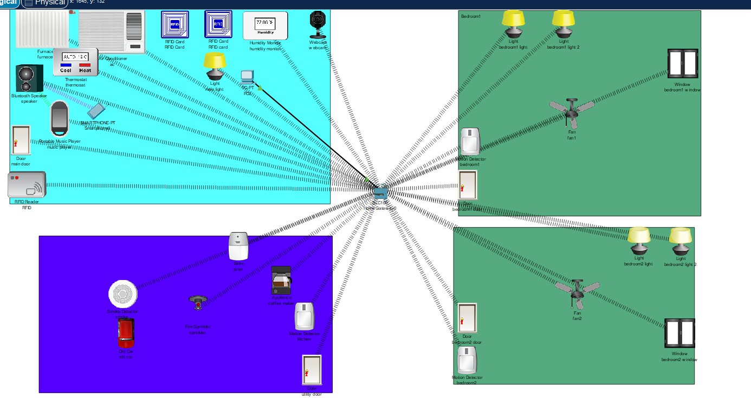
Logical Model

Slide 4
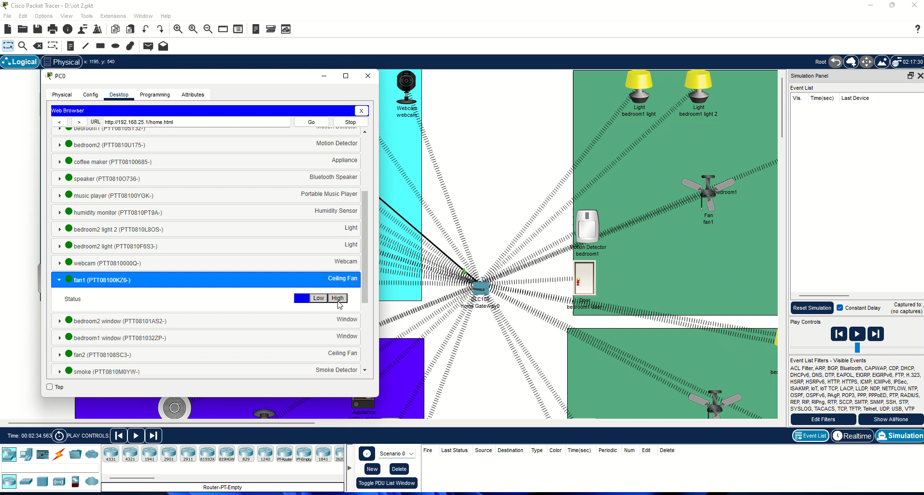
Working

Slide 5
Advantages
Minimizes The Human Work and effort
Saves Time And Effort
Good For Personal Safety and Security
Disadvantages
It Is Very Difficult To Plan , Build , Manage And Costly
Highly Dependent On Internet And Home Gateway

Slide 6
THANK YOU

